Slide 1
Power Consumption Prediction
Presented By :- Jay Riziya .

Slide 2
AGENDA
Introduction
Data Collection
Data Cleaning
Data Pre-processing
Exploratory Data Analysis (EDA)
Model Selection
Model Training

Slide 3
Introduction
Their goal is to create a machine learning model capable of accurately predicting power consumption in Zone 3.
To achieve this, we have compiled specific historical data, including power consumption records, weather conditions, and potential emission diffusion metrics. By analyzing these factors, we aim to develop a model that can effectively anticipate energy demand, enabling us to make informed decisions regarding efficient expansion into further zones.

Slide 4
Data Collection
Improved forecasting: Accurately predicting power consumption in Zone 3 will enable us to optimize resource allocation across our grid, ensuring a reliable and efficient energy supply.
Cost savings: Anticipating peak demand periods can potentially reduce our reliance on expensive peak-hour energy sources.
Sustainability: Understanding the factors influencing power consumption will inform strategies for promoting energy efficiency and integrating renewable energy sources into Zone 3.

Slide 5
Data Cleaning & Preprocesing
FUNCTION | OPERATIONS
df=pd.read_csv(“”) | Importing our dataset into Data frame and storing in df (i.evariable) (pd refers to pandas)
df.head(), df.tail() | To Display the first 5 Rows and last 5 Rows
df.shape() | array dimensions that tells the number of rows and columns of a given Data Frame.
df.info() | Display columns ,datatypes, non-null count and memory usage
df.describe() | Provides summary statistics of data like mean, median, minimum, maximum and more
df.isnull().sum() | Check the Total missing /null values
df.duplicated().sum() | Check the duplicate values

Slide 6
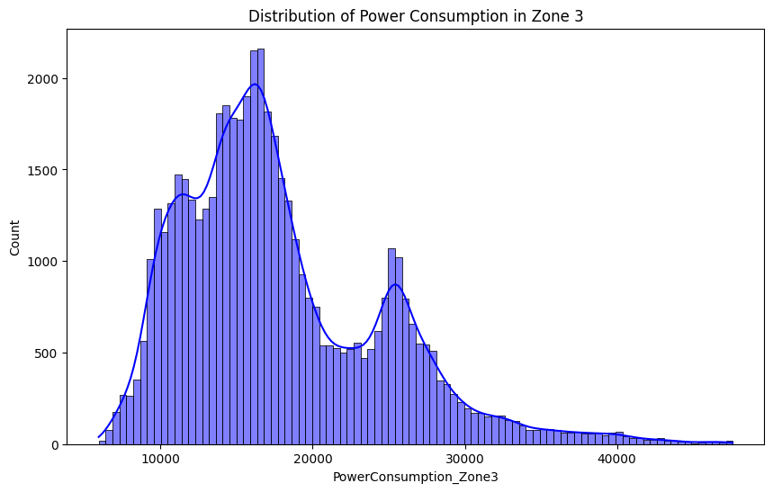
Exploratory Data Analysis

Slide 7
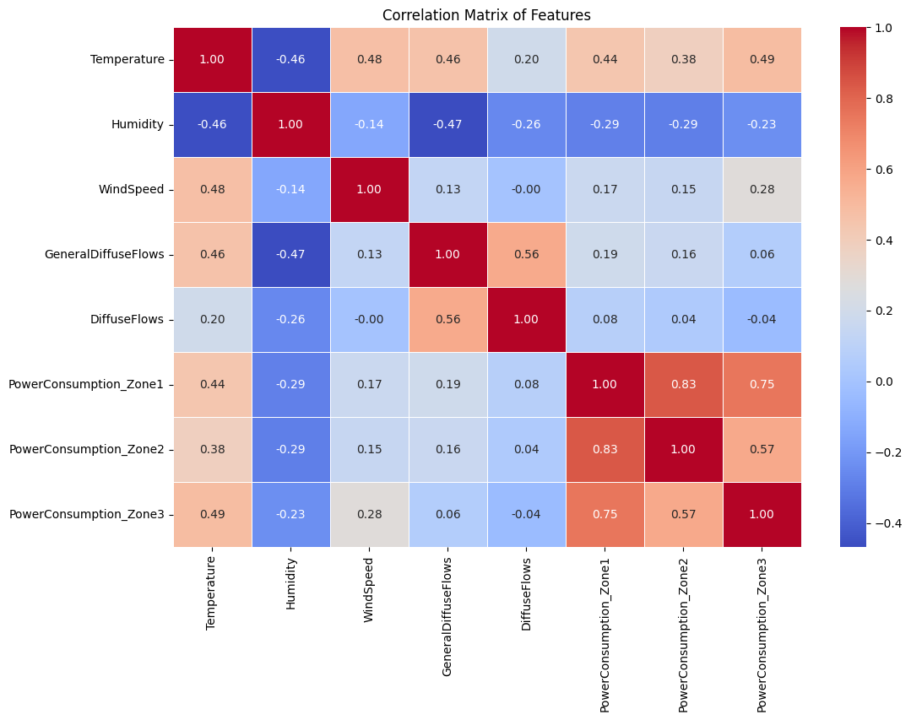
Data Visualization

Slide 8
Machine Learning
# Define the target variable and features
target = 'PowerConsumption_Zone3'
features = df.drop(columns=[target]).columns
X = df[features]
y = df[target] X_train, X_test, y_train, y_test = train_test_split(X, y, test_size=0.2, random_state=42) scaler = StandardScaler()
X_train = scaler.fit_transform(X_train)
X_test = scaler.transform(X_test)

Slide 9
Splitting Data and Scaling Features
# Initialize the model
model = RandomForestRegressor(random_state=42)
# Hyperparameter tuning using GridSearchCV
param_grid = {
'n_estimators': [100, 200, 300],
'max_depth': [10, 20, 30],
'min_samples_split': [2, 5, 10]
}
grid_search = GridSearchCV(estimator=model, param_grid=param_grid, cv=5, n_jobs=-1, verbose=2)
grid_search.fit(X_train, y_train)
# Best parameters and model
best_params = grid_search.best_params_
best_model = grid_search.best_estimator_
# Train the best model
best_model.fit(X_train, y_train)

Slide 10
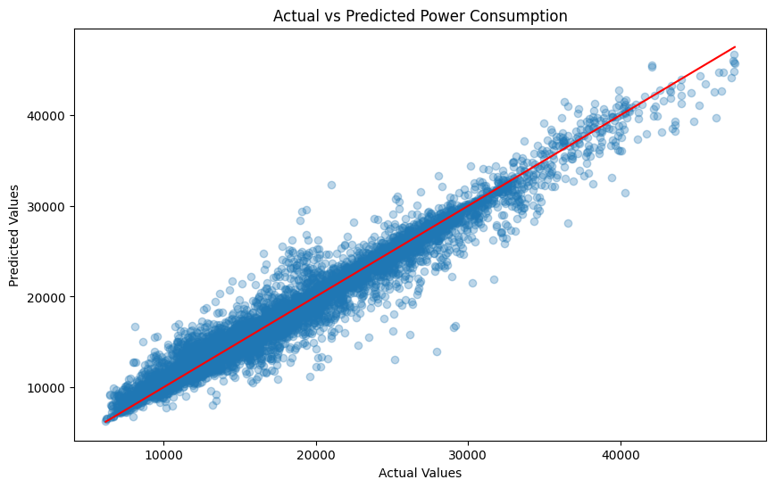
Results and Conclusion
MODEL
R-squared | 95%

Slide 11
Thank You !
Jay Riziya

